Slide 1
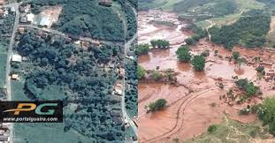
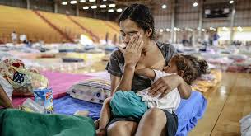
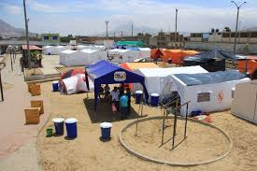
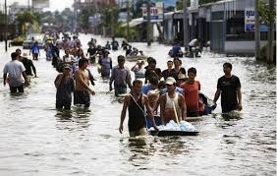
INDIVIDUAL DAMAGE AND ITS MASS PROJECTION: MANDATORY INSURANCE IN A FIRST-PARTY INSURANCE MODEL AS A TOOL FOR RESILIENCE IN THE FACE OF ENVIRONMENTAL DISASTERS PERY SARAIVA NETO
IWP 3 – CLIMATE & CATASTROPHIC EVENTS

Slide 2
ADVERSE SELECTION
CONCLUSION
SPREADING RISKS
FIRST AND THIRD-PARTY INSURANCE
MASS DAMAGES
THE PROBLEM
ENVIRONMENTAL DISASTERS AND INDIVIDUAL DAMAGE
MANDATORY
ENVIRONMENTAL
INSURANCE
MORAL HAZARD

Slide 3
Thank you!
contato@perysaraivaneto.com.br

